Slide 1
VNC project
hai.bui & quy.dang

Slide 2
Agenda
Overview
Roadmap
Diagram
Components
Mission
VNCtalk Process

Slide 3
Overview
Manager: Bernd
Manager Technical: Amal, Phuong Vu
Developer: Quy Dang, Phuong Vu, Son Hoang
Tester: Jaydeep, Jay Rawal
Design: Sami

Slide 4

Overview
Language Programing:

Slide 5
Overview
Web site VNC product:
Mail
Chat
Video conference
webcam
screen sharing
document sharing
File transfer
Integrate SIP

Slide 6
Overview
Open source software using:
Web mail and mail server: zimbra
XMPP server: prosody
Chat client: Jappix Mini
Video: Jitsi meet + jicofo + jitsi video bridge
Screen sharing: jitsi meet

Slide 7
Overview
Open source software using (cons):
File transfer: stanza.io, IBB
Document sharing: etherpad
SIP gateway: JIgasi
SIP server: Freeswitch

Slide 8
Roadmap
Base: Mail + Chat + Video conference
File transfer
Support 3rd party client (chat, video call, file transfer)
SIP integrate (audio only)
Screensharing
License: basic and advanced.
Support Mobile

Slide 9
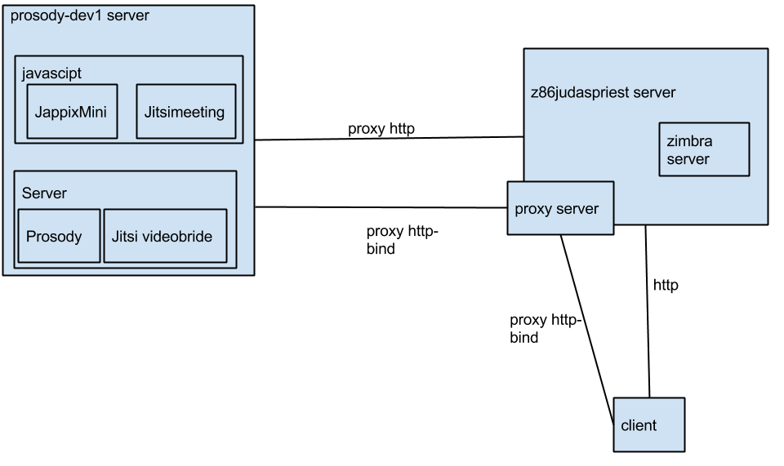
Diagram

Slide 10
Components
XMPP resource:
Chat: bob@prosody-dev1.vnctalk.de/ VNCChat(time)
Video: random@external.conference.prosody-dev1.vnctalk.de
File transfer: bob@prosody-dev1.vnctalk.de/file_transfer

Slide 11
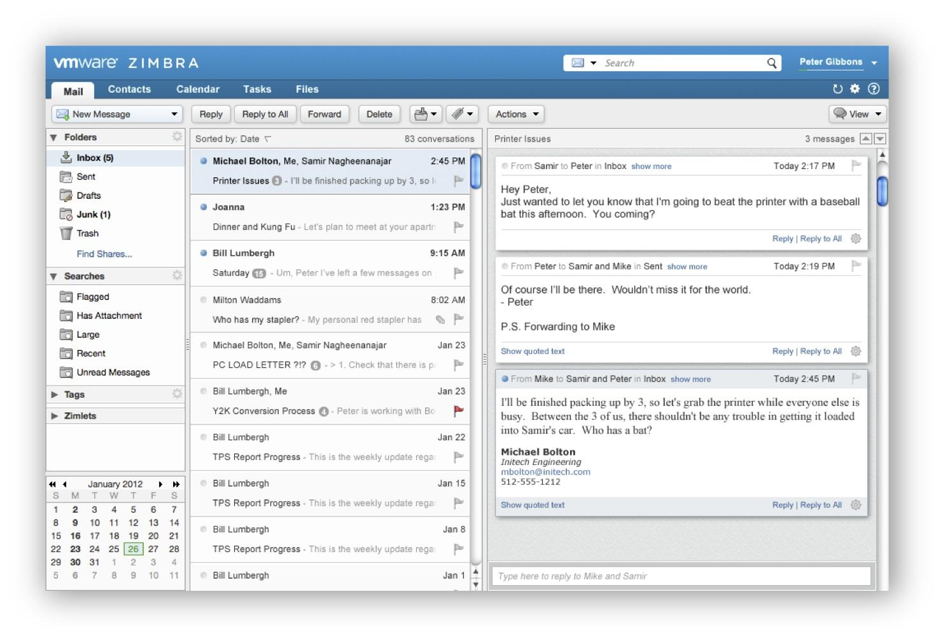
Components
Web mail and mail server:
Main UI
Mail service, mail API.
Calendar
Manage file
Admin interface

Slide 12
Admin interface
Manage user: add, remove, edit …
Distribute list (group chat)
Configure prosody address

Slide 13

Components
XMPP Server:
Signaling
Authentication external (LDAP)
HTTP-Bind
Restund server: (11.04)
STUN and TURN Server (TCP only)
Mod_turncredential (XEP-0215)

Slide 14

Components
Jappix-mini:
XMPP chat client.
Main chat module.
Jsjac library

Slide 15

Components
Jitsi Meet:
XMPP video client.
Strophe library.
WebRTC (XEP-0167)

Slide 16
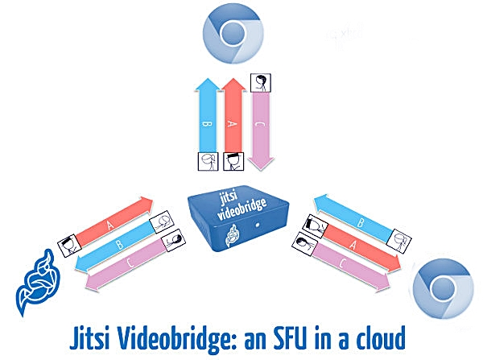
Components
Jicofo + Jitsi Video bridge

Slide 17
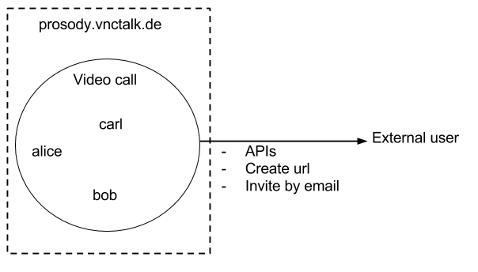
Components
External Video call

Slide 18
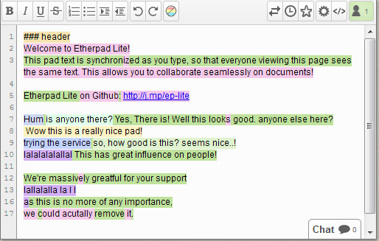
Components
Etherpad:
Document sharing.
Plugin in video conference function.
Revision

Slide 19

Components
File transfer:
Jingle Datachannel (XEP-0234)
Stanza.io
SCTP/DTLS
Note:
bob@htk.com send alice@htk.com
bob@htk.com/file_transfer send alice@htk.com/file_transfer
Notes:
hien tai cai nay minh da implement lai roi, dang su dung window size tuong tu nhu tcp

Slide 20

Mission
Fix bug:
Chat: presence, history, web site integration,...
Video: web site integration, css, presence,…
Document sharing: css, etherpad server,...
Screen sharing

Slide 21

Mission
Feature request:
File transfer: implement, modify source code,...
License
External video conference
Implement new UI

Slide 22

Mission
Suggest solution for new feature, bug, road map,...
Documentation
Communication
Commit code

Slide 23
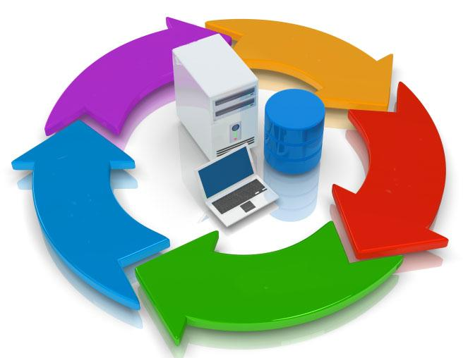
VNCtalk Process
Working process
Estimate
Status
Comment & discussion
Meeting daily: 3h30 pm
Email report: every 3,5 & 6
Communication: VNCtalk room
Commit Code: target ticket

Slide 24
Update tickets

Slide 25
External authentication

Slide 26
SLOGAN
We are a Virtual Organization.
Contact and communication
is very important.

